Slide 1
Car Price Prediction
Tinu Shiby

Slide 2
Problem Statement
Covid-19 have impacted the market in various aspects, during the lockdown and after we have seen a lot of changes in the car market. Now some cars are in high demand hence making them costly whereas some are not. Our client is the one who works with small traders, who sell cars. With the change in market due to covid 19 impact, our client is facing problems with their previous car price valuation machine learning models. So, they are looking for new machine learning models from new data. We have to make a car price valuation model. The project includes two phases, data collection and model building.

Slide 3
Data Collection
Details of used cars was scrapped from the website cardhekho.

Slide 4
About the dataset
Dataset have 5093 entries with 9 variables, which is split into train data and test data.

Slide 5
Approach towards the problem
Considered Price as target variable and rest everything as feature variables.
By bivariate analysis tried to figure out which all factors have significance on price prediction

Slide 6
Exploratory Data Analysis
After careful data analysis it was found out that following factors have high correlation with the target variable:
Company
Engine
No.of owners

Slide 7
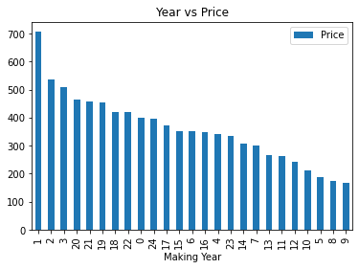
Making year vs Price

Slide 8
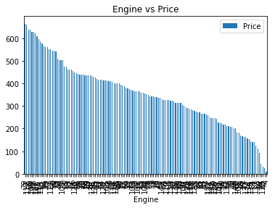
Engine vs Price

Slide 9
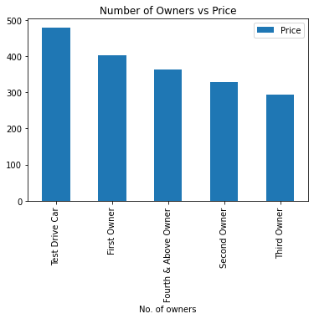
No. of owners

Slide 10
Data Preprocessing Steps
Removed outliers by z-score method
Removed the skewness using power transform
Dropped the columns Unnamed: 0 as they have no contribution towards price
Applied StandardScalar to standardize the data
153 was considered as the best random state

Slide 11
Model Training
Developed the following models:
Linear Regression
Decision Tree
Random Forest
Gradient Descent Boosting
SVR
XGBoost

Slide 12
Best Model
XGBoost Regressor turns out to be the best model as it has the least difference between R2 score and cross-validation score

Slide 13
Hyper Parameter Tuning
Using GridSearchCV hyper parameter tuning is applied on XGBoost model with the following parameters:
Learning rate : 0.06
Max_depth : 10
Min_samples_leaf : 1
N estimators : 80
After Hyper Parameter tuning the accuracy increased to 47%

Slide 14
Conclusion
It was found out that Making year, engine and number of owners plays a crucial role in predicting price.
XGBoost turns out to be the best model with an accuracy of 47%

Slide 15
Thank You

